Slide 1


Sampling in the frequency domain generates a repeating signal in the time domain. The period of the constructed “sample” would equal to T=1/Δf, where Δf is the sampling interval in the frequency domain. For F_c<<Ω, Rabi osclliation only take a very short time, and the phase drift φ seen by the experiment is nearly linear, as the graph below shows. It looks like we need a large number of Rabi osclliations to get the whole picture of the time series.
$$S_{φ}(f)$$
Power Spectral Density
$$F_{c}$$
Ω
Δf
f
Generated sample time series
A sample of
phase noise φ(t)
2π/Ω
Τ
2Τ
t
Time for one round of Rabi.

Slide 2

$$S_{φ}(f)$$
Power Spectral Density
For F_c>Ω, the noise changes duing the Rabi cycle. Simulations could capture the details within the t= 2π/Ω. However, as long as the period of the sample has T>2π/Ω, one round of Rabi still cannot capture the whole picture of the time series.
Δf is the lowest sampling frequency in the IDFT, correspond to the longest-period oscillating term in the time domain.
Ω
$$F_{c}$$
Δf
f
Generated sample time series
A sample of
phase noise φ(t)
2π/Ω
Τ
2Τ
t
Time for one round of Rabi.

Slide 3
The “undersample problem” in the time domain exists for both high- and low-bandwidth noises.
Our current scheme:
Generate one sample of the time series and do one round of numerics with the sample
Repeat 1 for multiple times, generating a new time series sample each time.
Take average
Should we…… ?
Generate one sample of the time series and do multiple round of numerics with this sample. Then take the average.
Repeat 1 for multiple times, generating a new time series sample each time.
Take average from different time series.

Slide 4


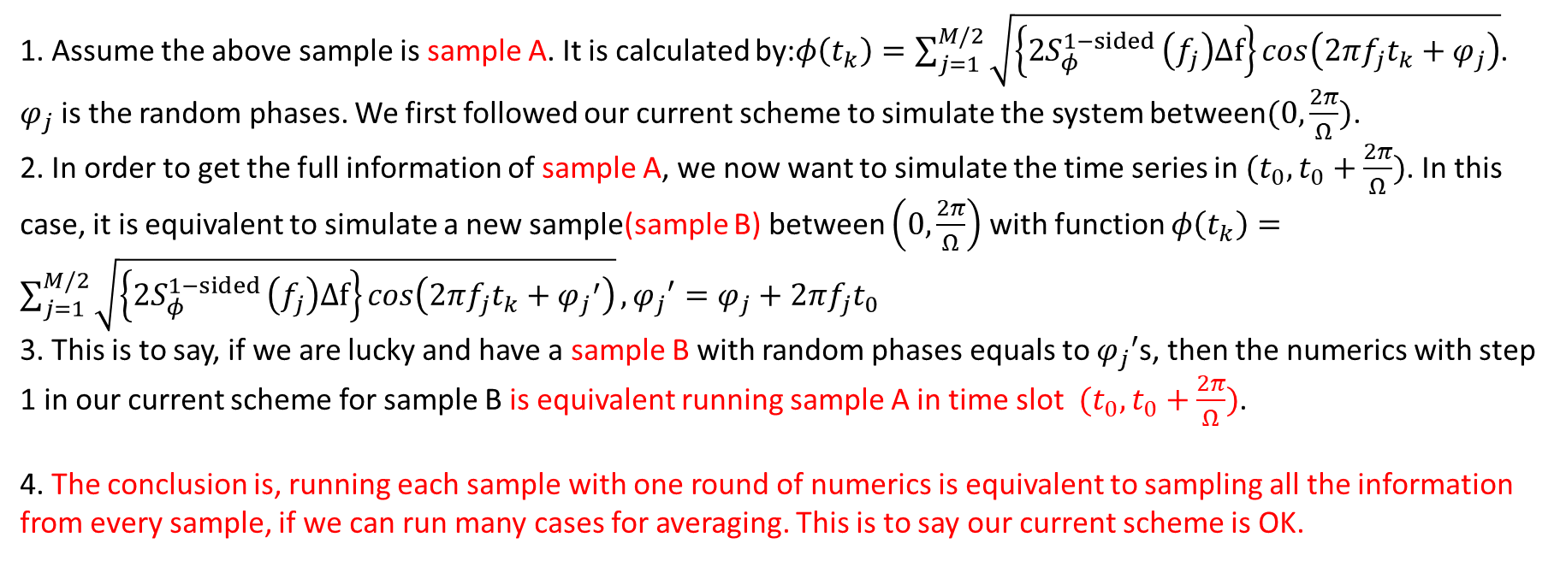
Generated sample time series
(sample A)
A sample of
phase noise φ(t)
2π/Ω
$$t_{0}$$
$$t_{0}+2π/Ω$$
Τ
2Τ
t
1. Assume the above sample is sample A. It is calculated by:$φ\left(t_{k}\right)=\sum_{j=1}^{M/2}{\sqrt{\left\{2S_{φ}^{1−sided }\left(f_{j}\right)Δf\right\}cos\left(2πf_{j}t_{k}+φ_{j}\right)}}$. $φ_{j}$is the random phases. We first followed our current scheme to simulate the system between$(0, \frac{2π}{Ω})$.
2. In order to get the full information of sample A, we now want to simulate the time series in ${(t}_{0}, t_{0}+\frac{2π}{Ω})$. In this case, it is equivalent to simulate a new sample(sample B) between $\left(0, \frac{2π}{Ω}\right)$ with function $φ\left(t_{k}\right)=\sum_{j=1}^{M/2}{\sqrt{\left\{2S_{φ}^{1−sided }\left(f_{j}\right)Δf\right\}cos\left(2πf_{j}t_{k}+{φ_{j}}^{′}\right)}},{φ_{j}}^{′}=φ_{j}+2πf_{j}t_{0}$
3. This is to say, if we are lucky and have a sample B with random phases equals to ${φ_{j}}^{′}$s, then the numerics with step 1 in our current scheme for sample B is equivalent running sample A in time slot ${(t}_{0}, t_{0}+\frac{2π}{Ω})$.
4. The conclusion is, running each sample with one round of numerics is equivalent to sampling all the information from every sample, if we can run many cases for averaging. This is to say our current scheme is OK.

Slide 5
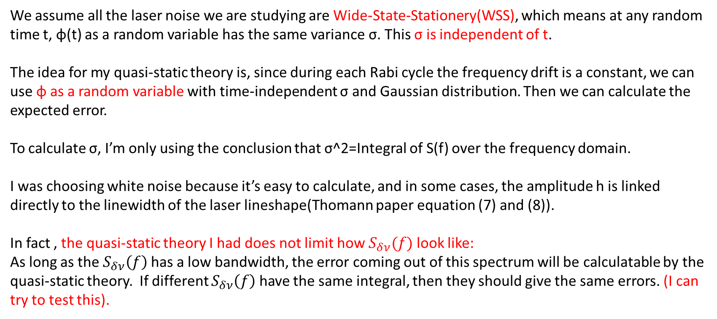
We assume all the laser noise we are studying are Wide-State-Stationery(WSS), which means at any random time t, φ(t) as a random variable has the same variance σ. This σ is independent of t.
The idea for my quasi-static theory is, since during each Rabi cycle the frequency drift is a constant, we can use φ as a random variable with time-independent σ and Gaussian distribution. Then we can calculate the expected error.
To calculate σ, I’m only using the conclusion that σ^2=Integral of S(f) over the frequency domain.
I was choosing white noise because it’s easy to calculate, and in some cases, the amplitude h is linked directly to the linewidth of the laser lineshape(Thomann paper equation (7) and (8)).
In fact , the quasi-static theory I had does not limit how $S_{δν}(f)$ look like:
As long as the $S_{δν}\left(f\right)$ has a low bandwidth, the error coming out of this spectrum will be calculatable by the quasi-static theory. If different $S_{δν}\left(f\right)$ have the same integral, then they should give the same errors. (I can try to test this).

